Slide 1
Environment Topics
What will today’s problems bring tomorrow?

Slide 2
Section 1
Overview Of Pollution

Slide 3
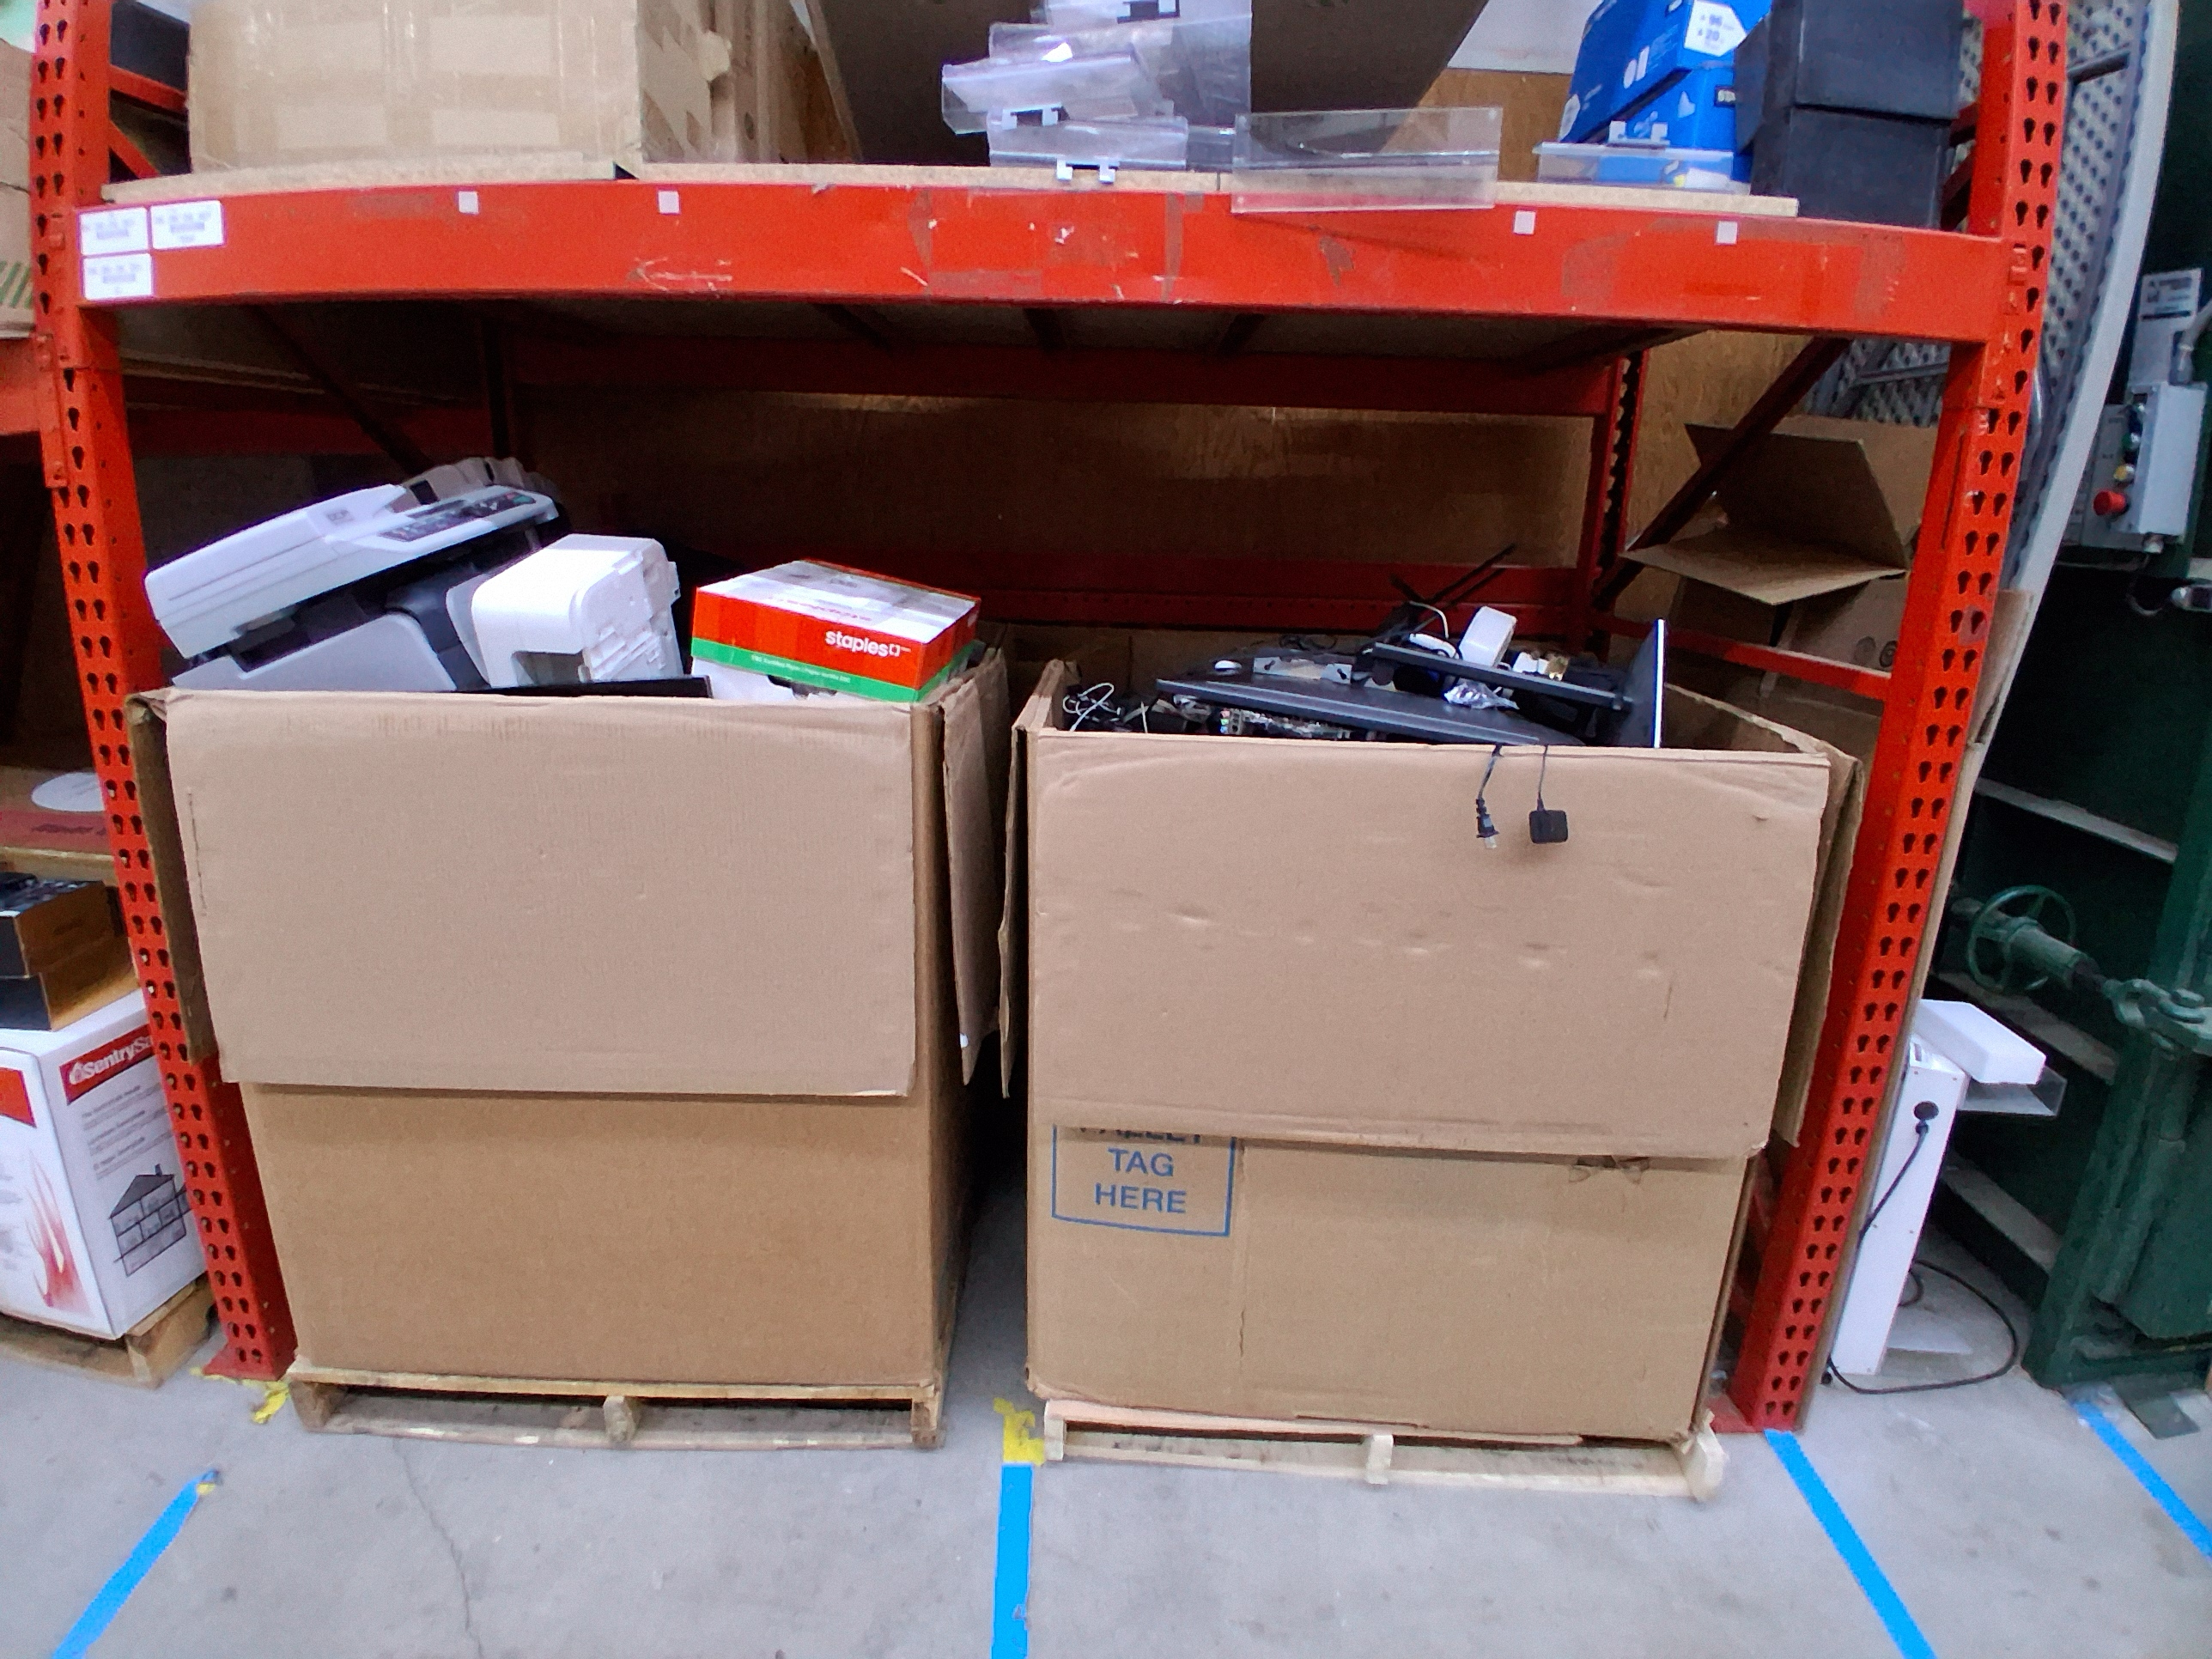
Some Big Picture Questions
What is pollution, and who defines what counts as “pollution”?
Is pollution a technology problem, a human behavior problem, or both?
Has modern life made pollution inevitable?
Are we solving pollution — or relocating it?

Slide 4
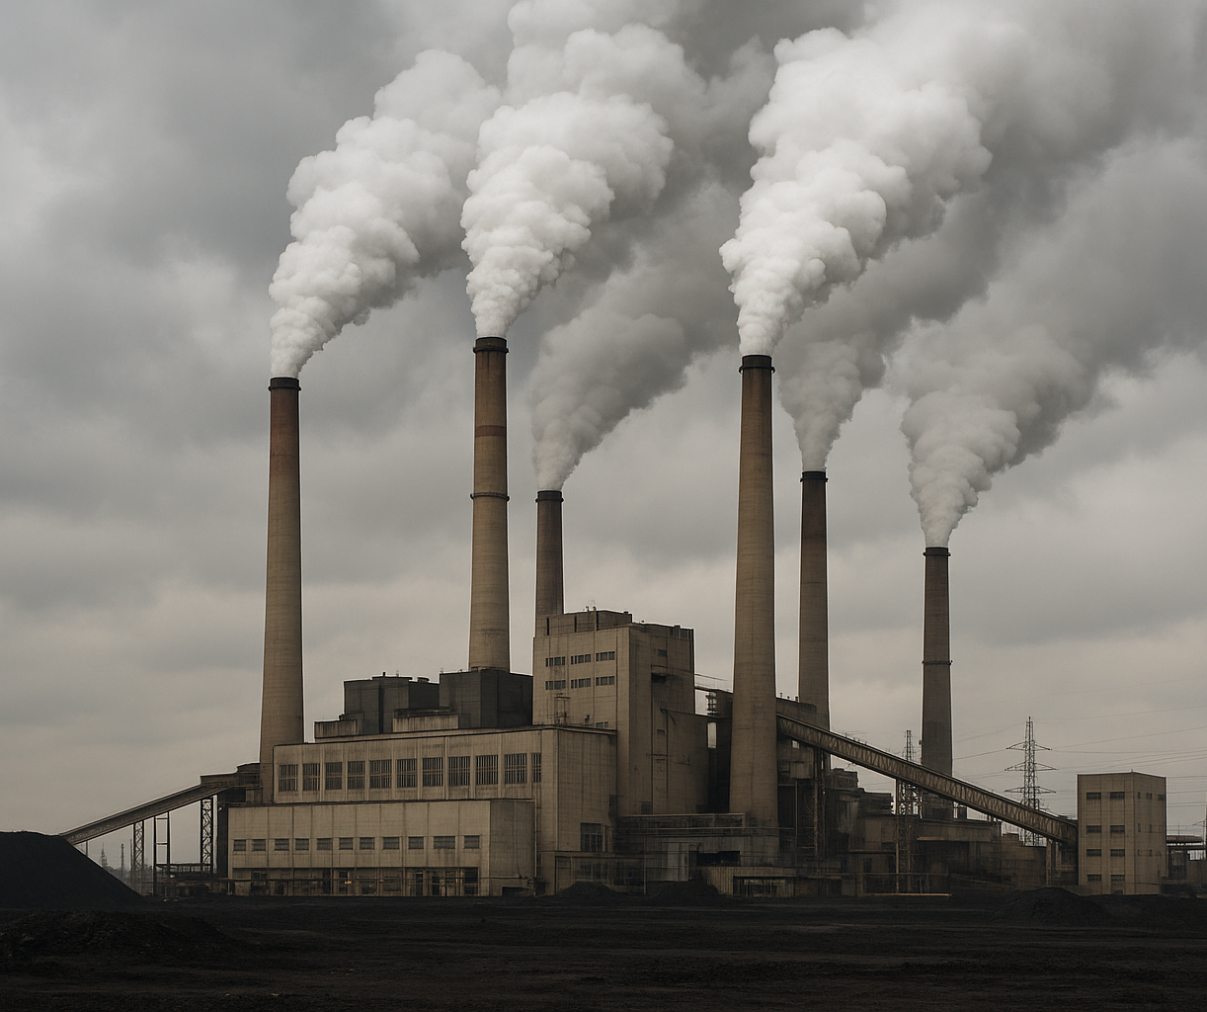
Reflective Statements
The way we handle waste reveals our priorities as a society.
Pollution is a visible symptom of invisible economic systems.
Technological progress without environmental consideration creates long-term costs.
The future of pollution depends on design choices made today.

Slide 5
Trade-Off & Systems Thinking Questions
When does a “green” technology create hidden pollution elsewhere?
Is recycling a solution — or a management strategy?
Who benefits from polluting technologies? Who suffers?
Can technology fix problems created by earlier technology?
Is prevention more powerful than innovation?
Should technological progress slow down for environmental protection?
What responsibility do engineers and developers have?
Can economic growth exist without increasing pollution?
What role should government regulation play?
What does a “sustainable” technological future look like?

Slide 6
To consider for our future!
Technological progress should not necessarily slow down, but it must be guided by environmental responsibility and long-term thinking.
Engineers and developers have an ethical duty to design technologies that reduce harm and consider full life-cycle environmental impacts.
Economic growth can exist without increasing pollution, but only through clean energy, efficiency, and circular design rather than increased consumption.
Government regulation is important to set environmental standards, prevent harm, and protect communities that are disproportionately affected by pollution.

Slide 7
Continued…
A sustainable technological future focuses on durability, repairability, renewable energy, and waste reduction.
“Green” technologies can create hidden pollution through resource extraction, manufacturing, or disposal if full systems are not considered.
Recycling is often a management strategy rather than a complete solution, since it handles waste after it is created.
Polluting technologies often benefit producers and consumers, while environmental and health costs are borne by vulnerable communities.
Technology can help fix problems created by earlier technology, but it works best when combined with prevention strategies.
Prevention (designing systems to avoid pollution) is generally more powerful and cost-effective than trying to clean up damage later.

Slide 8
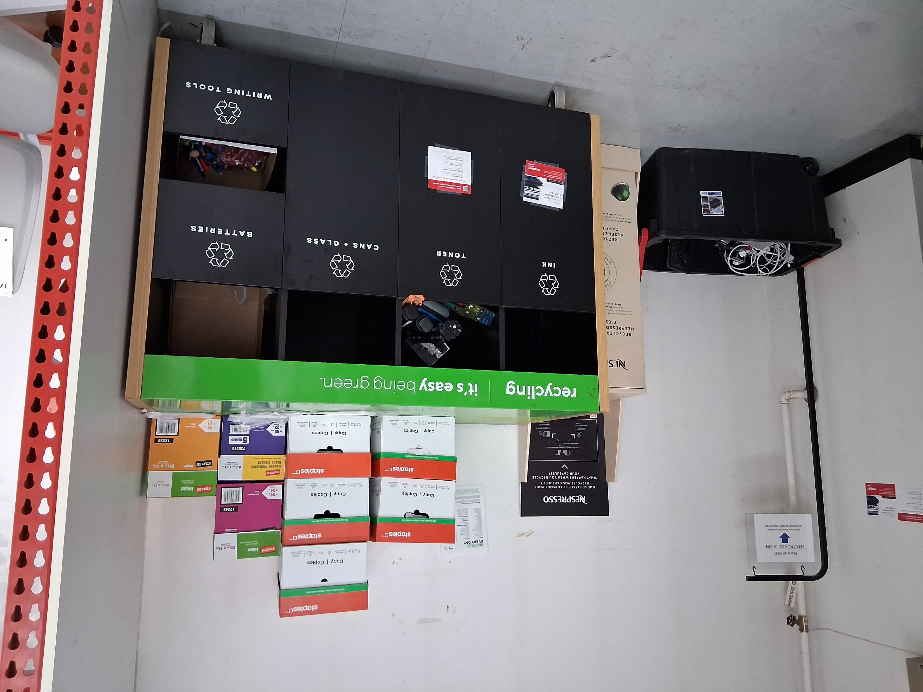
Is it important for companies to do recycling programs?
Staples has a recycling program. They take the following:
Electronics
Nespresso
Printer Ink and Toner
Cans and Glass
Batteries
Writing Tool (such as pens & highlighters)
They do NOT take other items such as lightbulbs, canisters, paint cans, and more.

Slide 9
Section 2
Recycling

Slide 10
If pollution is a systems problem, then recycling is one system designed to respond to it.
Is recycling enough?

Slide 11
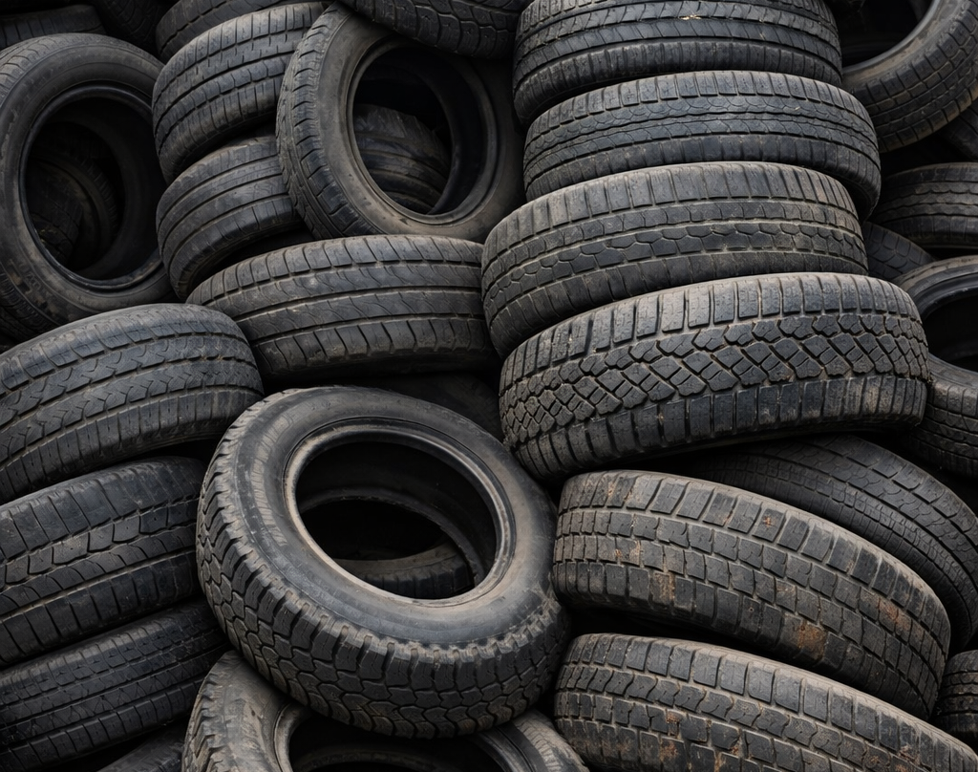
What can be recycled?
Plastics
Glass
Cardboard
Metals
Electronics
Tires
Batteries
Pens
Printer Ink and Toner
And more…

Slide 12
Normal Recycling (General Recycling)
What it is? Everyday materials that can be safely collected and processed through standard municipal recycling systems.
Examples:
Paper and cardboard
Glass bottles and jars
Aluminum and steel cans
Certain plastics (#1, #2, sometimes #5 depending on location)
Characteristics:
Low hazard risk
Collected curbside or in public bins
Processed in standard recycling facilities
Relatively simple sorting and reprocessing
Goal: Recover materials and reduce landfill use.

Slide 13
Special Waste Recycling (Hazardous or Controlled Recycling)
What it is? Materials that require special handling, storage, or treatment because they may be toxic, flammable, corrosive, or environmentally harmful.
Examples:
Batteries (especially lithium-ion)
Electronics (e-waste)
Paints and solvents
Motor oil
Fluorescent bulbs
Medical waste
Characteristics:
Potential environmental or health risks
Cannot go in regular recycling bins
Collected at designated depots or events
Requires specialized processing technology
Goal: Prevent contamination, fires, toxic exposure, and environmental damage.

Slide 14
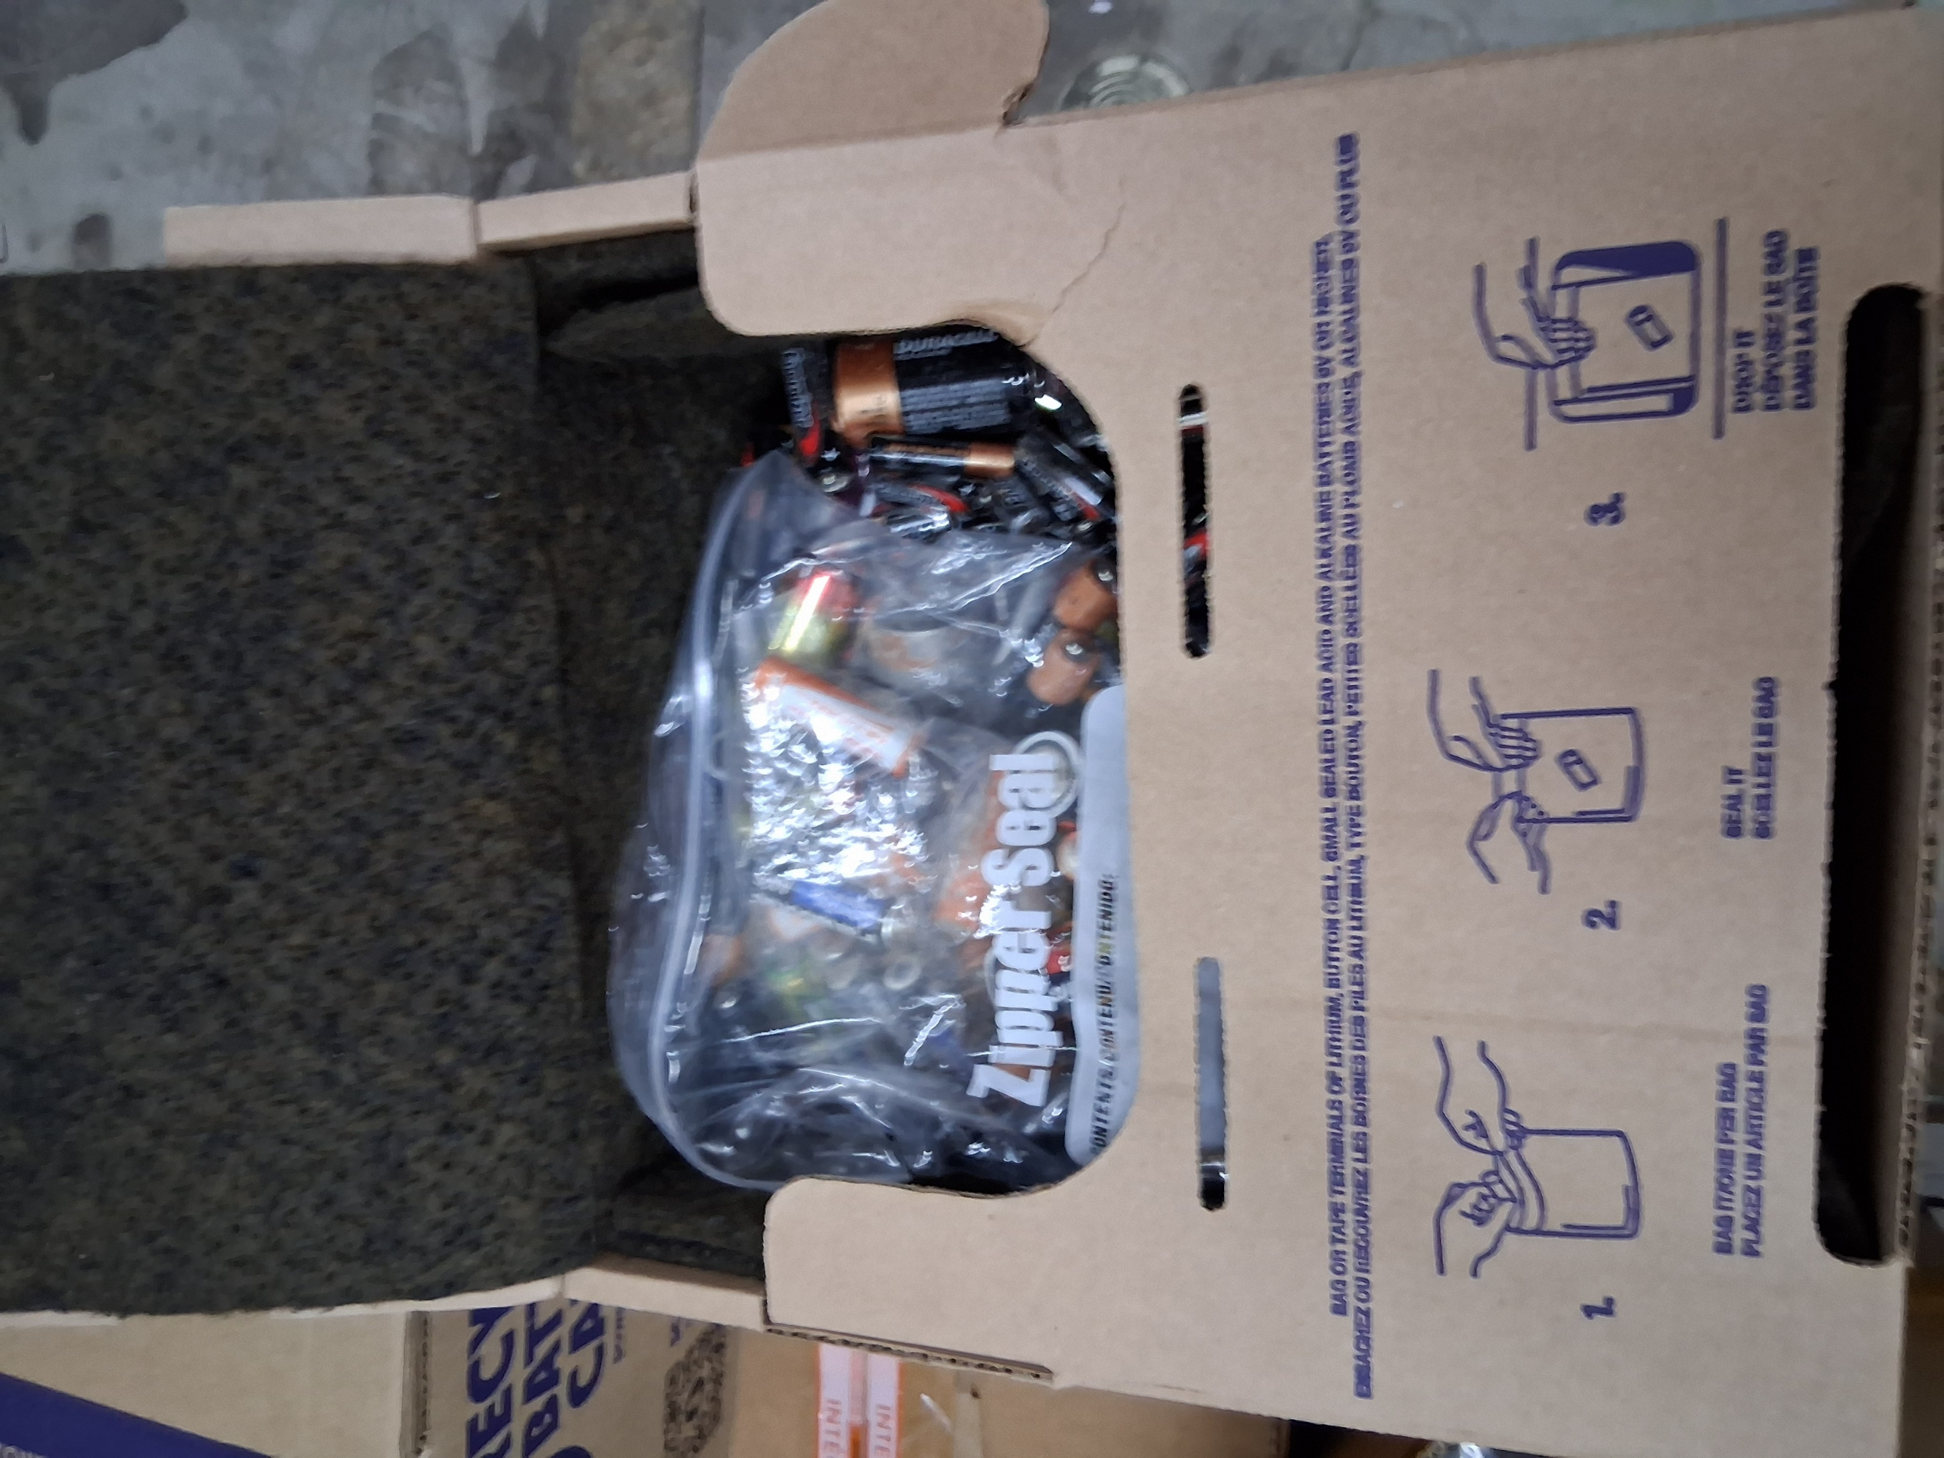
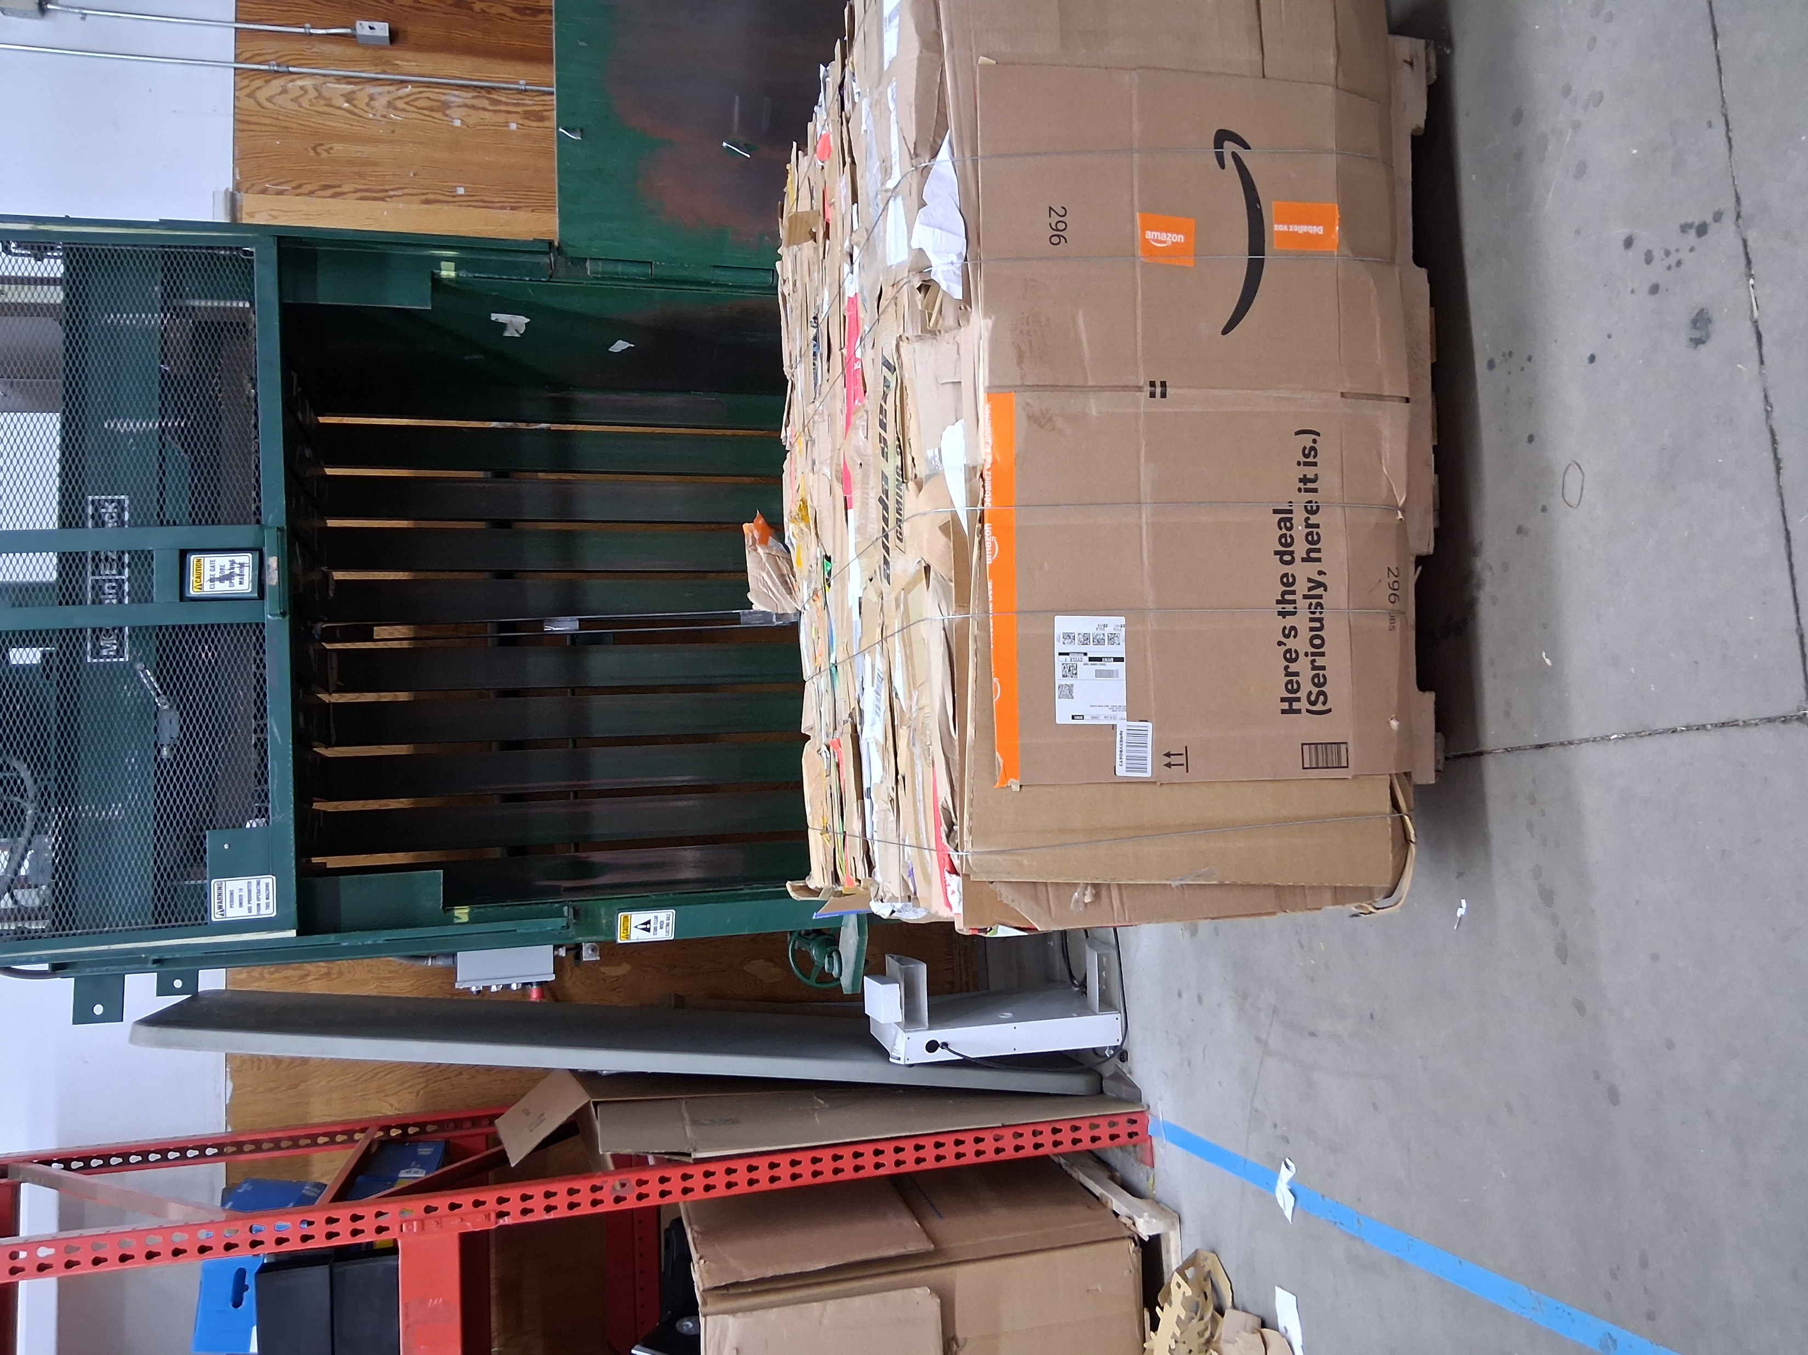
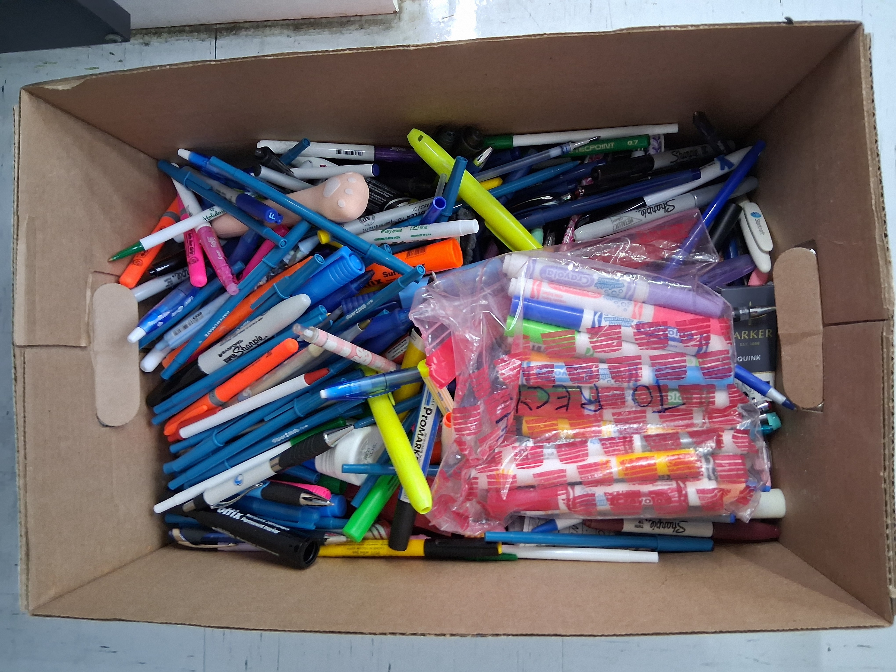

Slide 15
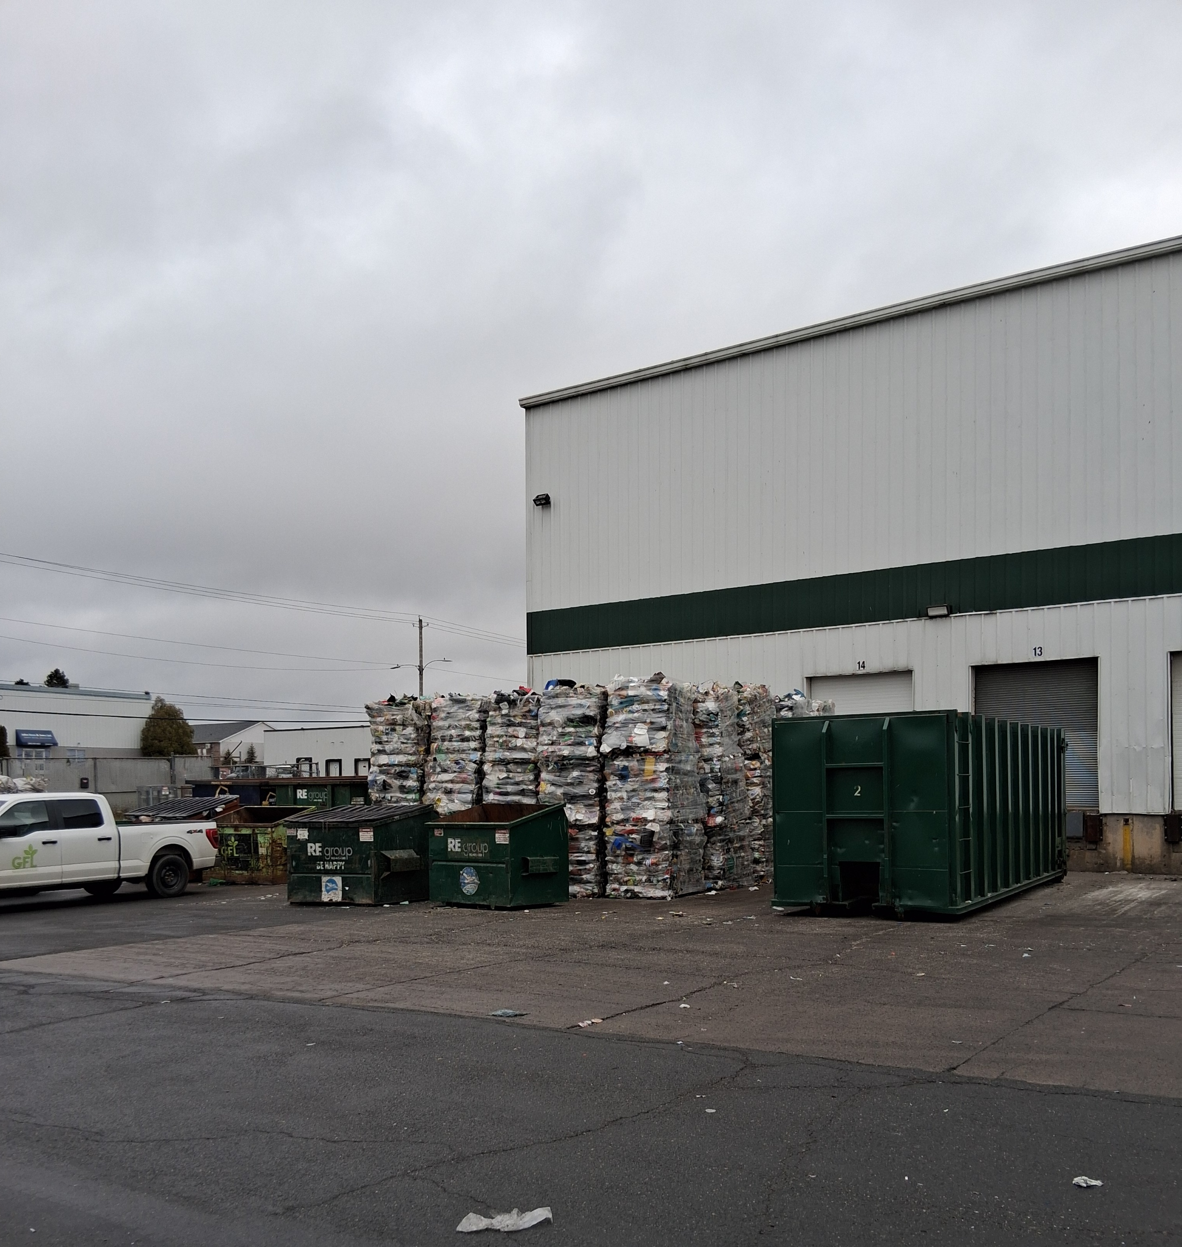
Is there technology that can help us with recycling?
What technology does recycling plants have now?
What technology could help improve recycling plant?
Can that technology be sustainable? For example, can parts be easily replaced by any skilled labourer?
The image is from a recycling plant in Halifax, Nova Scotia.

Slide 16
Videos of Cardboard Bails Being Made Created by Peter Vaughan
Video One
https://www.youtube.com/shorts/kMo65vud9M4
Video Two
https://www.youtube.com/shorts/Yju5AaPls00
Video Three
https://www.youtube.com/shorts/nrAy-dqpeu8
Video Four
https://www.youtube.com/shorts/suGrXu1sXb8

Slide 17
Classroom Reflection
How much material passes through our daily lives?
What does a single bale represent in terms of trees, energy, and transportation?
Is recycling enough, or should we rethink consumption itself?
What does this volume of material say about global trade and consumer behavior?
Does recycling solve the problem, or manage the symptoms?
What role does technology play in reducing material waste?

Slide 18
Section 3
Litter

Slide 19
While recycling focuses on system design, litter shows us the human behavior side of pollution.
Why do people litter?

Slide 20
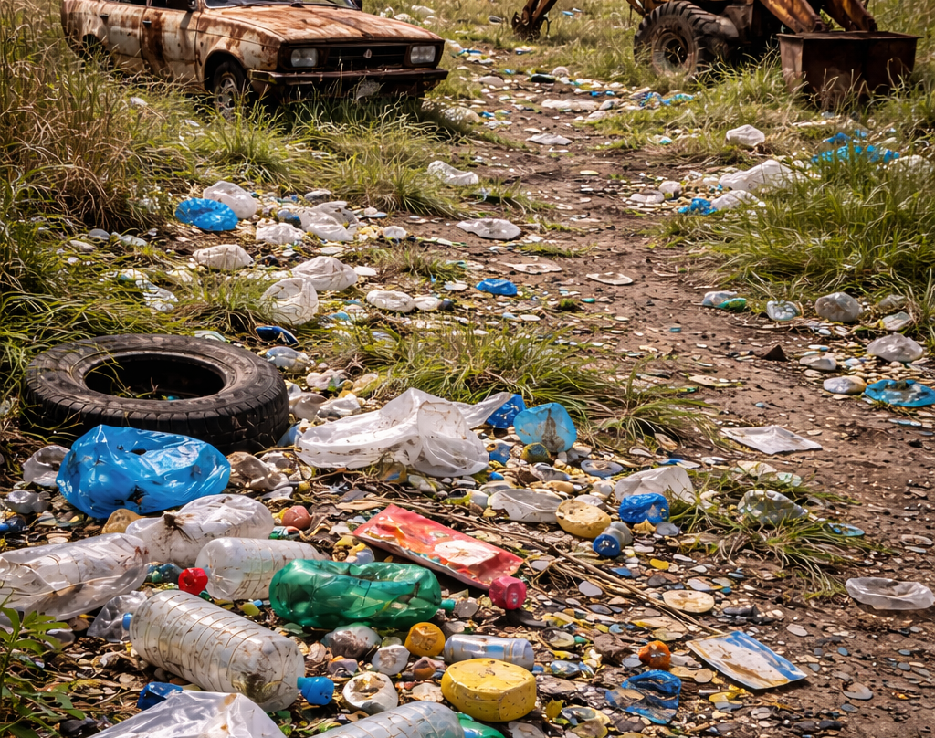
Litter and Trash
What is pollution? Why does it exist?
Who pollutes the world?
Where do we pollute? At work? At home? At school?
How do we fix pollution? Can it be solved?
How do we stop certain pollution such as littering?
Can technology help us?

Slide 21
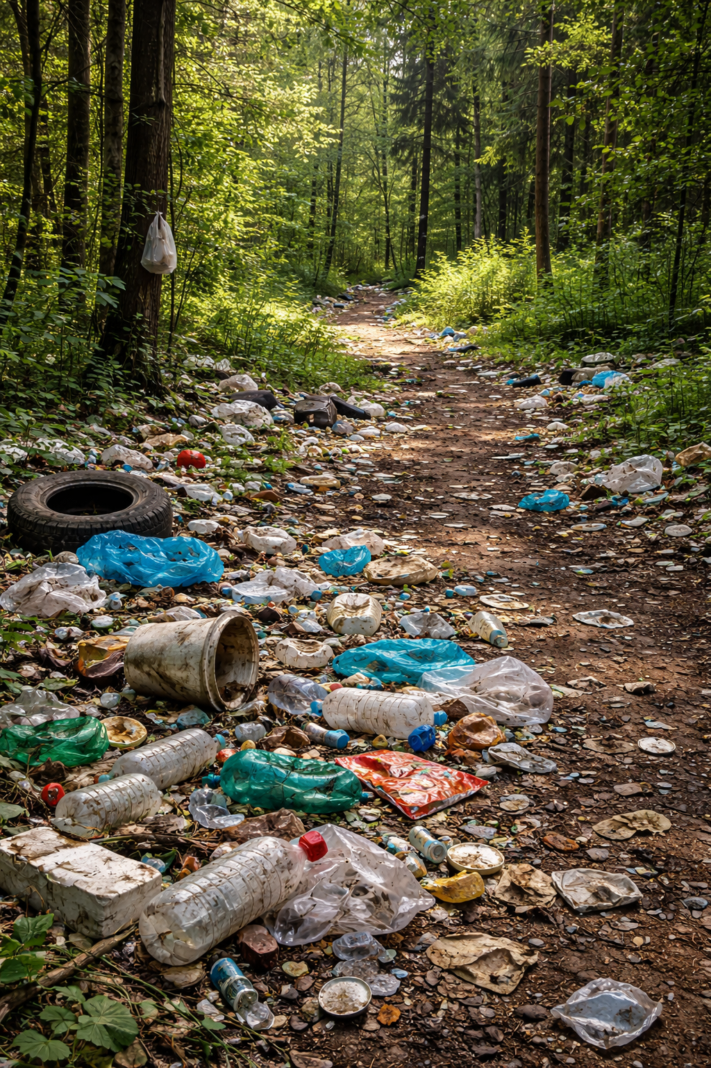
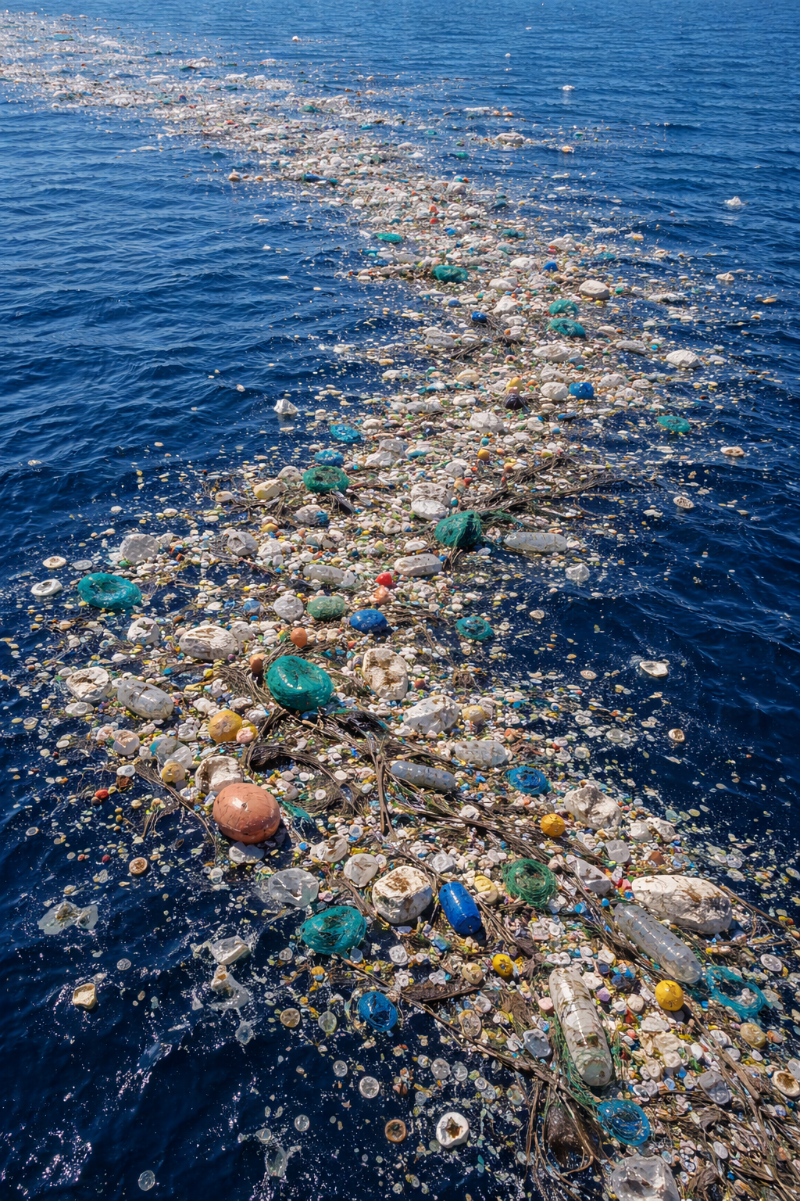
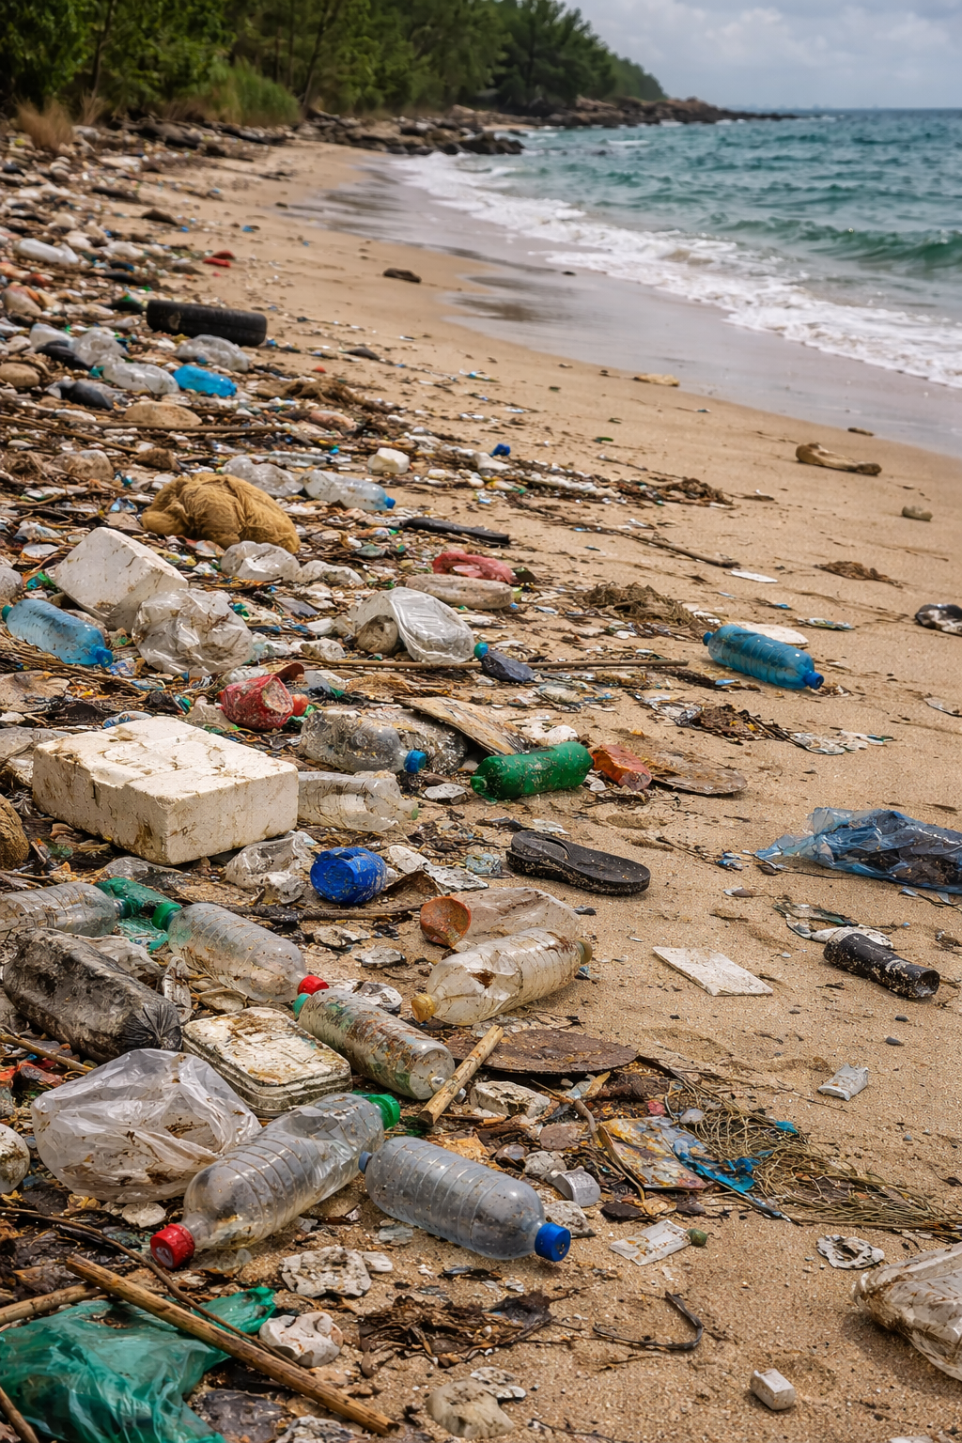

Slide 22
Video
Litter Video in the Philippines
Questions
https://youtube.com/shorts/u9qJGSxHBKk
Created by Jhun Reblando
Every area can be affected by litter. How does litter affect your area and mood?
Why do you think people litter?
How do we solve this problem of litter? Reflect on if fines and other punishments work.

Slide 23
Section 4
Conclusion

Slide 24
Any Questions?
Any topics should we discuss more?

Slide 25
How would you solve one part of an environment problem?
Present on the problem, the pros and cons of your solution, and the reason this is important to do.

Slide 26
The End
Thank you for your time.

